Slide 1

Choose Ohio First Scholarship Program (COFSP)
Professional Development
Debbie Liberi and Lori Cooper
Professional Development Session 1:
Part 1: COFSP, RET and CEEMS Components Overview
Part 2: Introduction to Challenge Based Learning
840 Old Chemistry
University of Cincinnati
Friday, September 23, 2016
3:15 - 5:15 pm

Slide 2
Acknowledgements
Research Experiences for Teachers (RET) Funded by NSF’s RET Program: Grant # EEC-1404766.
Ohio Board of Regents: OBR COF 08-23 Grant

Slide 3
WHO are the KEY players?
COFSP Fellows – 6 senior engineering students, recipients of Choose Ohio First Scholarship Program
RET Teachers – 8 classroom teachers who participated in the Research Experiences for Teachers grant this past summer.
CEEMS Teachers – 2 classroom teachers from Cincinnati Enhanced Engineering, Math and Science Program, Cohort 4, who are involved in creating 5- 6 units on CBL and EDP.
CEEMS Fellows – 4 Engineering PhD Candidates who are CEEMS Fellows grant recipients.

Slide 4
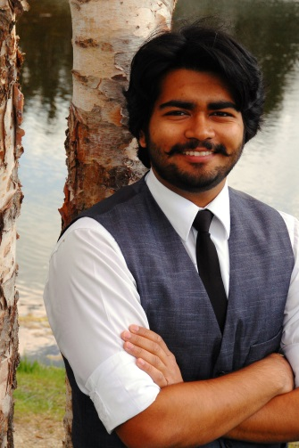
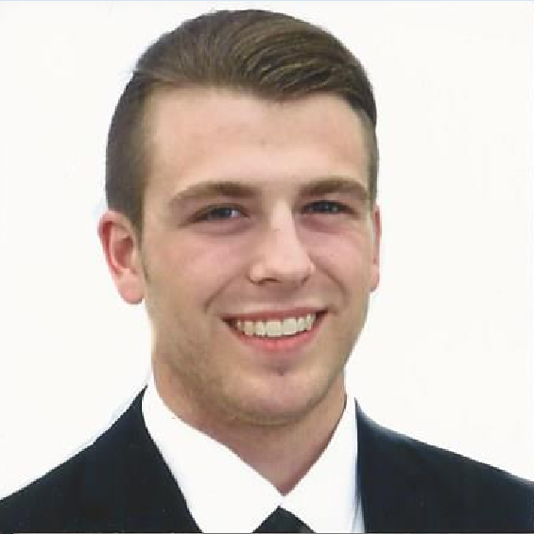
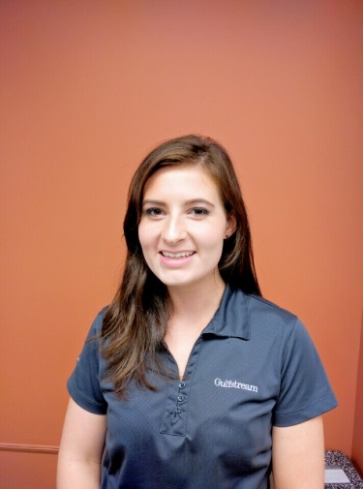
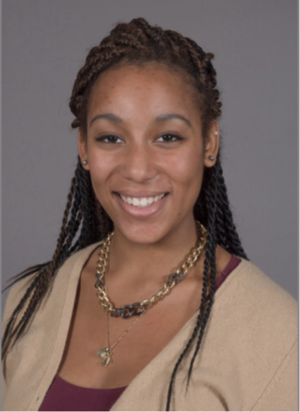
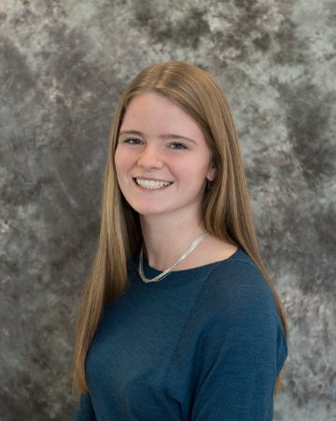
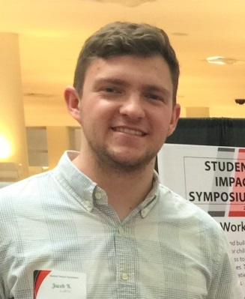
Introductions: COFSP Fellows
6 COFSP Fellows: Please stand.
    James Fiorini
    Neah Gray
    Jacob Knorr
    Chirau Patel
    Lydia Smoot
    Emma Stumpf

Slide 5
Introductions: 8 RET Teachers - Please stand
Amy Parker – Physics Grades 11 and 12, Biology 10, Environmental Science, Grades 11 and 12, Finneytown HS
Nancy Schreder-Vossen - Biology Grade 9, Zoology Grades 11 and 12, Kings HS, Kings Mills
John D’Alessandro - Comprehensive Physics, Grade 12, AP Physics C, St. Xavier HS, Private
Mike Day – Algebra 1 Grades 9 and 10, Advanced Pre-Calculus Grade 11, Discrete Math Grade 12, Statistics A, Statistics B, and an intro to Engineering class Grades 11 and 12, Reading HS, Reading

Slide 6
Introductions con’t: RET Teachers
Matt Brunner - Science Grades 6, 7, and 8, and Grade 7 Math, Saints Peter and Paul School California, KY
Samantha Lafin - Clean Energy Technology and Engineering Grade 9, Biology Grade 10, Scott HS. Taylor Mill ,KY
Jim Prugh - Advance Pre-Calculus, Algebra 1 Grade 9, Indian Hill HS, Indian Hill
Sam Mizener - CP Algebra 1 Grade 9, Geometry Grade 10, Programming Grades 9 -12, Kings HS, Kings Mills

Slide 7
Introductions: CEEMS Teachers
PD Session 1 on September 23rd:
Lori Cooper– Teaches 7th grade Science at Western Hills High School, Cincinnati Public Schools District
PD Session 2 on September 30th:
Amy Jameson - Teaches Physics, Chemistry and Anatomy and Physiology at Dater High School, Cincinnati Public Schools District

Slide 8
CEEMS Fellows
(PhD Candidates in Engineering)
Caroline Akenyi
Anne Brant
Sumeet Chaudhary
Siddharth Sridhar

Slide 9

Why bring in COFSP Fellows into the RET classrooms?
They are great role models for the field of engineering.
Students in the classroom relate to them.
They provide practical applications of math and science.
They make students aware of the variety of engineering careers and what engineers actually do with the goal to encourage students to pursue STEM careers.
They assist in the RET/CEEMS Teacher’s classroom – an extra set of eye for formative assessments.
They share their Senior Capstone projects.

Slide 10

What are the components of the COFSP Fellows, RET Teachers and CEEMS Fellows 2016-17 Program?
#1 Professional Development Component→
Activity Development with ongoing Support
CEEMS Teacher plan and present the Professional Development to COFSP Fellows on Challenge Based Learning (CBL) and Engineering Design Process (EDP) pedagogies, as well as, Unit design using academic content standards.

Slide 11
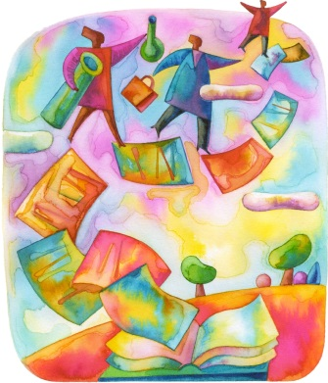
Components of the COFSP Fellows, RET Teachers and CEEMS Fellows 2016-2017 Program
#2 Activity Development → Support from
RET Teachers, RET Coordinator and
CEEMS Fellows.
RET Teacher and COFSP Fellow select a topic.
COFSP Fellow submits a draft to CEEMS Fellow.
COFSP Fellow gets feedback from RET Teacher and RET Coordinator.
COFSP Fellow finalizes Activity based on feedback.

Slide 12
Components of the COFSP Fellows, RET Teachers and CEEMS Fellows 2016-2017 Program
#3 Activity Implementation → Support from
RET/CEEMS Teachers and RET Coordinator
COFSP Fellow teaches Activity.
COFSP Fellow completes the “post teaching” portions of Activity Template.
COFSP Fellow gets feedback from RET Teacher and RET Coordinator.
COFSP finalizes Activity on template based on feedback.
COFSP Activities are published on the website.

Slide 13

Components of the COFSP Fellows, RET Teachers and CEEMS Fellows 2016-2017 Program
#4 Bi- Weekly Seminars → Support from RET Coordinator and CEEMS Fellows
COFSP Fellow keeps a journal.
COFSP Fellow conducts discussion based on readings.
COFSP Fellow completes other assignments designated by RET Coordinator.

Slide 14
Components of the COFSP Fellows, RET Teachers and CEEMS Fellows 2016-2017 Program
#5 Deliverables → Support from RET Teachers, RET Coordinator and CEEMS Fellows,
COFSP Fellow completes a reflective essay.
COFSP Fellow prepares a Power Point.
COFSP Fellow prepares a Poster.
COFSP Fellow presents at Final Culmination Event.

Slide 15
RET / Teachers and RET Coordinator
COFSP Fellows
CEEMS Fellows
KEY Players Provide:
      Preparation
      Support
      Planning
      Preparation
      Feedback
      Mentoring

Slide 16

Questions?
Components?
Key players?
Objectives or benefits?

Slide 17
Announcements Regarding PD Next Week - Friday, September 30th:
We are meeting in 840 Old Chemistry
Refreshments will be provided.
Meeting time again is 3:15 – 5:15 PM.
The topic will be Engineering Design Process.

Slide 18

Time for Meeting in Groups
Agenda for next 20 minutes
Introductions among group members. (3 minutes )
Fellows and RET Teachers will discuss schedule for first week (Week of October 3th – 7th. (10 minutes)
Examination of timelines. (7 minutes)
* Handouts are provided for reference.

